Slide 2
Gorgeous Gorse Hill Annual General Meeting 26 January 2017

Slide 3
Activity in 2016
Three Key Projects:
Mural, Sculptures & Benches at Ravenswood Rest Space
Pocket Park on Canal Bridge
New for Old Tree Project

Slide 4
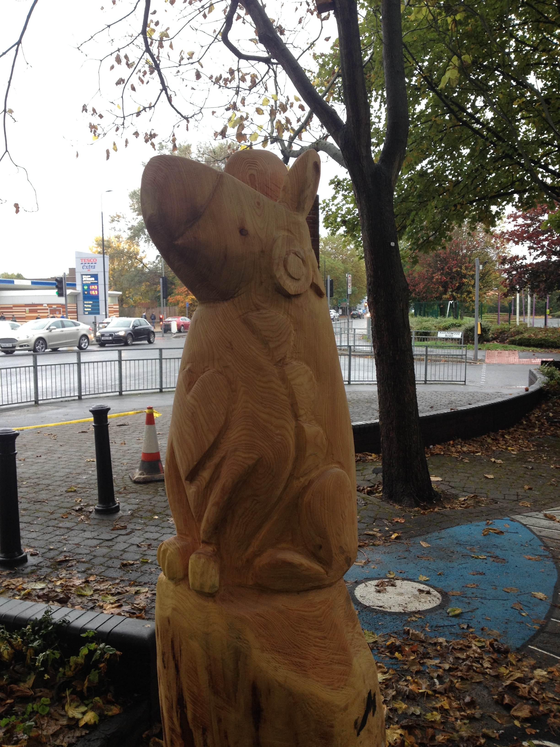
Mural & Sculptures

Slide 5
Pocket Park

Slide 6
New for Old Tree Project

Slide 7
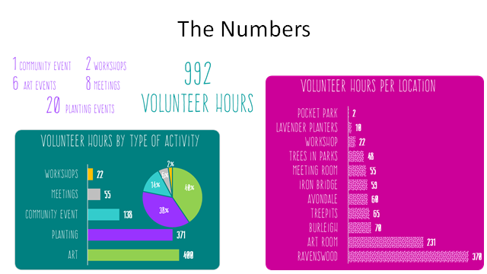

Slide 8
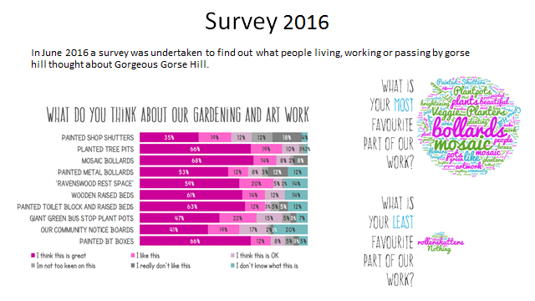

Slide 9
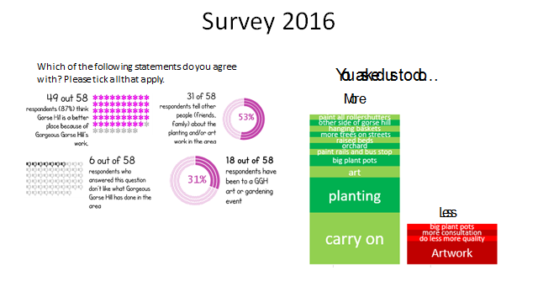

Slide 10
Gorgeous Gorse Hill Finances
Opening balance | £2,973.71
Income
Manchester Airport | 1,800.00
Justgiving – donations for stolen tree | 287.16
Adactus Housing Association | 78.40
Trafford Housing Trust - Stretford Grant (New for Old) | 1,658.33
Localgiving.com | 566.56
Groundwork UK - Tesco Carrier bags | 8,000.00
TOTAL | £12,390.45
Expenditure
Groundworks for planters | 332.52
Laserlea | 215.00
BUD Garden Centre plants for pocket park | 258.65
Wainwright Timber Ltd | 1,944.00
Groundwork UK – pocket park | 9,000.00
Additional expenditure | 789.69
TOTAL | £12,539.86
Income minus expenditure | -£149.41
Closing balance | £2,824.30

Slide 11
Gorgeous Gorse Hill Committee Elections
Chair, Treasurer and Secretary plus three – four additional committee positions
Who would like to put themselves forward & anyone wishing to stand down?

Slide 12
Plans for 2017
Recruit, Recruit, Recruit – we need more volunteers. The Gorse Hill Pledge?
Maintenance and building on our existing sites
Unrestricted Fundraising
Tree Pit Competition
Plant Swap & Cake Event
Make a Hanging Basket
Christmas Event

Slide 13
Thank You
We would like to thank:
All our volunteers
Our local councillors especially Laurence Walsh & Mike Cordingley
All our donors big and small
Our Artists
Our Partners and Supporters

